Slide 1
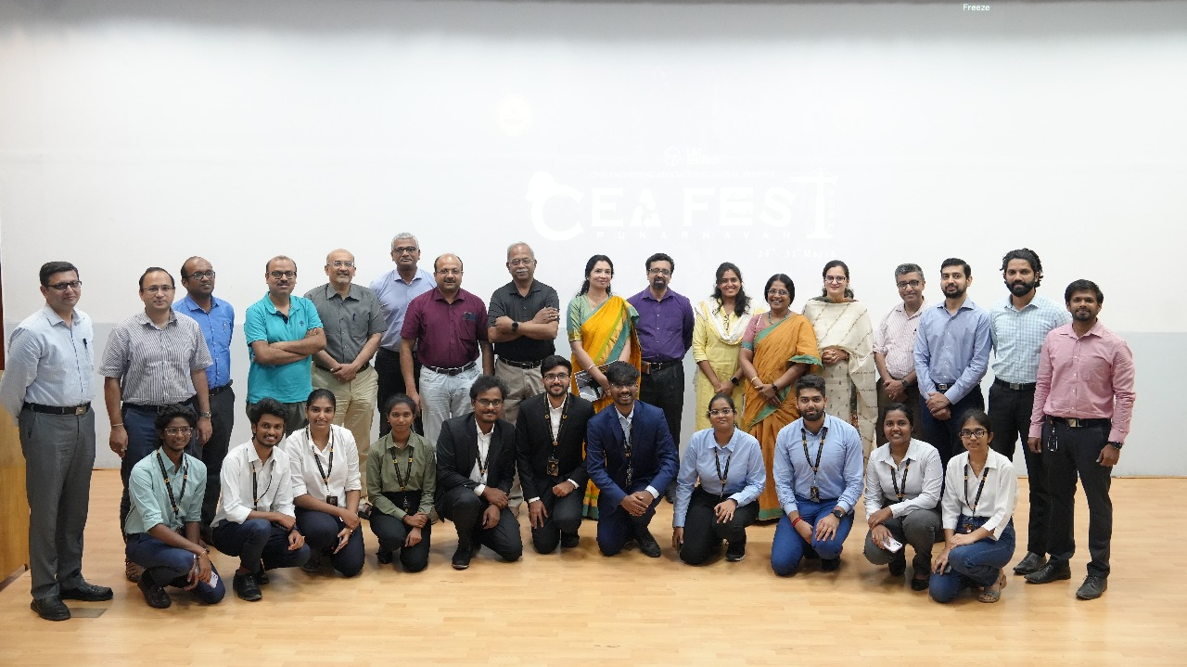
Civil engineering association fest - 2025
DATE : 16.04.2025 VENUE: IIT MADRAS

Slide 2
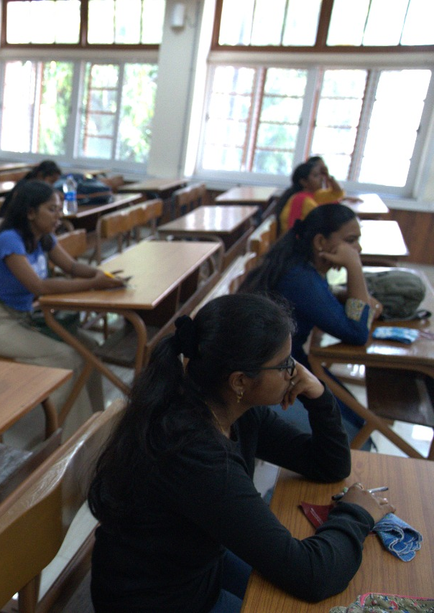
Agenda
1 | ABOUT US
2 | WORKSHOPS
3 | EVENTS
4 | REGISTRATIONS
5 | ACCOMODATION

Slide 3
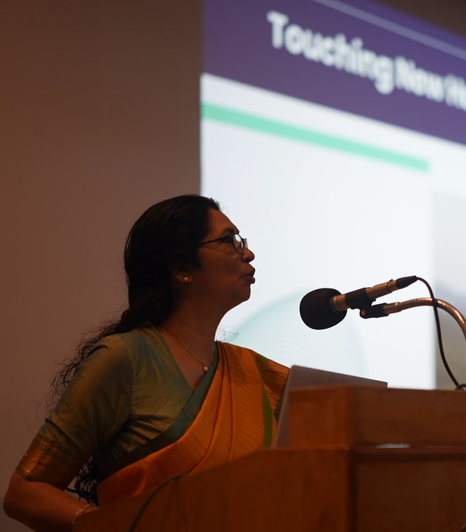
ABOUT US
The Civil Engineering Association (CEA) was formed with the primary aim of exposing potential civil engineers to the challenges of the profession.
With both students and faculty as its members, the organization is one of the most active Civil Engineering Associations in India.
CEA organizes activities like lectures by distinguished practitioners of the profession, video shows, competitions and socially relevant projects for the students throughout the year.
The CEA activities of a year culminate in the CEA Fest. Civil Engineering Association Fest of IIT Madras is the largest student run civil engineering fest in India .

Slide 4
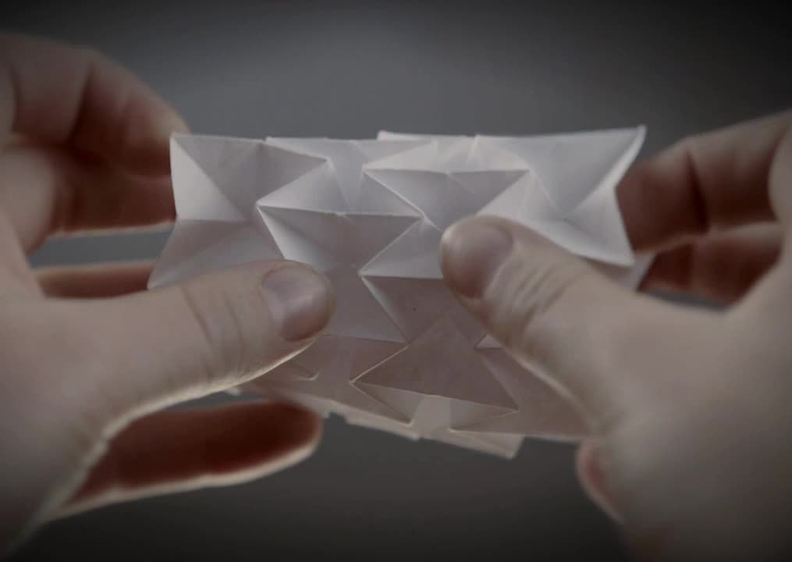
FOLDSTRUCT
Explore how origami mechanics can revolutionize architecture, robotics, and space structures! This competition challenges you to create innovative deployable structures inspired by paper-folding techniques.
Focus on folding principles, structural stability, and real-world applications to push the boundaries of design and engineering.
Test your creativity, problem-solving skills, and engineering instincts. Shape the future with adaptable and smart designs. Think. Fold. Build. Compete. Are you ready? 🚀

Slide 5
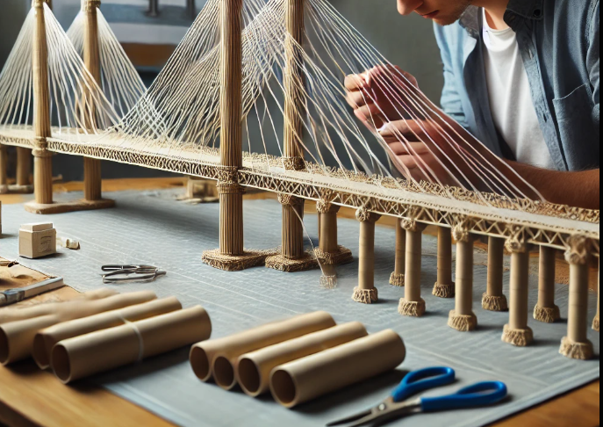
BRIDGE BLITZ
"Defy gravity, push boundaries, and build the ultimate lightweight marvel!" Step into the world of structural engineering with Cable Masters, where innovation meets practicality.
Participants will design and construct a cable-stayed suspension bridge using only newspaper and thread, adhering to specified dimensional constraints. The challenge?
Achieve the highest possible load-to-weight ratio, testing your understanding of load distribution, material strength, and creative problem-solving.
Do you have what it takes to craft a bridge that stands strong under pressure?
Gather your team, refine your design, and let your engineering skills shine in this thrilling structural showdown!

Slide 6

CASE STUDY
CEA FEST 2025

Slide 7

1.INFRA VISION
Infra Vision is a case study competition addressing real-world transportation challenges. Teams first compete in an online quiz on transportation concepts.
Top performers advance to the offline case study round, where they analyze the topics, propose solutions, and present to judges.
The event evaluates problem-solving, analytical skills, and practical understanding of transportation engineering.

Slide 8

2.ECOSOLVE
This case study explores the role of environmental engineering in addressing critical pollution challenges through innovative solutions.
As pollution continues to threaten ecosystems and public health, environmental engineers are at the forefront of developing technologies and strategies to reduce contamination in air, water, and soil.
The event focuses on a real-world engineering project where sustainable practices and advanced technologies were applied to mitigate pollution in a highly industrialized region
Each team will also submit a written case study, detailing their engineering design, methodology, and expected impact. Case studies will be assessed based on: Technical rigor and feasibility Environmental impact Innovation and creativity in addressing the specific challenge Potential for real-world implementation

Slide 9

BID TO BUILD
Teams will participate a s their own contractor firms and shall submit a technical bid for the project released by CEA IIT Madras.
Participating teams shall draft a detailed bill of quantity (BOQ) based on the plan and contract given to them. In addition, they shall give a presentation on how they deduced their BOQ.
Participants shall be judged on their ability to: a) Listing of materials b) Quantity estimation c) Fulfilling the contractual conditions d) QCBS This event will help participants gain valuable insights into the real world- challenges of executing a project.
It will help participants to hone their technical skills of: a) Reading a drawing b) Quantity estimation c) Understanding the Contractual Clauses d) Prepare a Bid ready for submission

Slide 10
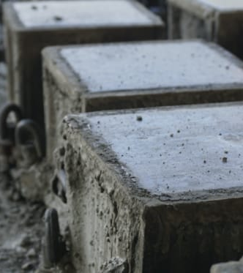
CONCRETE CHALLENGE
OPTIMIZATION OF CONCRETE MIX DESIGN THROUGH MECHANICAL AND SUSTAINABILITY PARAMETERS USING CRUMB RUBBER
This event invites participants to explore the process of incorporating crumb rubber into concrete, an innovative approach that not only strengthens the material but also reduces waste.
Throughout the event, you'll get to mix, mold, and test your very own concrete cubes, infused with recycled rubber to create a more resilient, eco-friendly product.
This event will showcase the numerous advantages of using crumb rubber, such as improved durability, enhanced flexibility, and a reduction in environmental impact

Slide 11
PRESENTATION
CEA FEST 2025

Slide 12

1) POTENTIAL PROFESSOR:
The "Potential Professor" event is a unique opportunity for students passionate about teaching to showcase their skills and receive valuable feedback from highly experienced professors.
This event aims to create a platform for aspiring educators to gain practical experience and refine their teaching methods.

Slide 13

2) RESEARCHERS CONCLAVE:
Researcher’s Conclave is an academic competition for postgraduate students, challenging them to present their research in the time provided.
The event focuses on communicating complex ideas in a concise and engaging manner to a non-specialist audience. It fosters storytelling and clarity, pushing participants to convey their work effectively within a strict time limit.

Slide 14

IDEATHON
Ideathon, an exciting platform for innovators, thinkers, and problem-solvers! This event brings together passionate participants to pitch their unique and groundbreaking ideas to a panel of esteemed professors.
Whether it's a tech innovation, social impact project, or a creative solution to a real-world problem, Ideathon offers a stage to turn your ideas into potential realities.
Participants will have the opportunity to present their concepts, articulate their vision, and showcase their creativity.
The event will be judged based on the originality, feasibility, and impact of the idea, as well as the effectiveness and clarity of the presentation.
The top ideas and best presentations will be recognized and rewarded, offering participants the chance to gain valuable feedback, mentorship, and exposure to academic and industry leaders. So, gear up to pitch your idea, impress the judges, and compete for exciting prizes and recognition!

Slide 15

ROUTE X
Buckle up for a high-octane challenge where code meets the streets! Route X calls on gearheads and coding pros to optimize automated vehicles using top-tier open-source simulation software.
Race against time to pilot a digital fleet through a dynamic urban maze, crafting the smartest routes and sharpest algorithms to balance speed, precision, and safety.
Who can engineer the ultimate AI-driven navigator to rule the roads? It’s time to shift your skills into high gear.

Slide 16
CODE
CEA FEST 2025

Slide 17
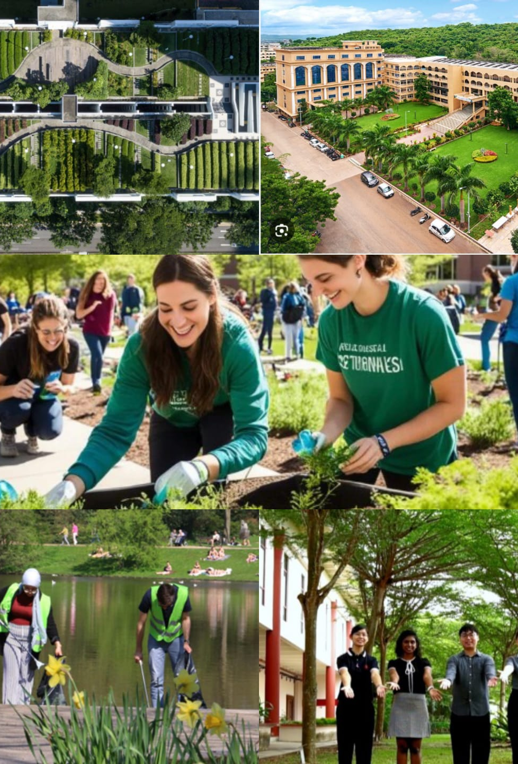
1. SUSTAINABLE CAMPUSES
The Sustainable Campuses Competition brings together colleges and universities from across the country to showcase their sustainability efforts.
Participants must complete a Sustainability Questionnaire detailing their campus initiatives and submit supporting evidence in PDF format, including images, videos, and statistical data.
Each institution will also prepare a 4-minute video and a detailed presentation, both of which will be pitched live in front of the judges.
Presentations should focus solely on sustainability practices and initiatives implemented on campus. Teams will have 10 minutes to present, with no extra time allotted.

Slide 18
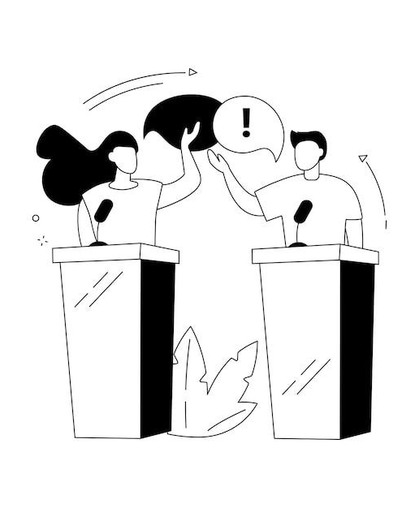
DEBATE
Step into the platform of intellect and innovation at the Debate Competition, where words build bridges and arguments lay foundations for the future!
This electrifying event challenges engineers to engage in riveting discussions on groundbreaking advancements, ethical dilemmas, and sustainability in civil engineering.
With every rebuttal and counterpoint, participants will navigate the ever-evolving landscape of infrastructure, innovation, and impact.
Gear up to clash with perspectives, fortify your stance, and leave a legacy of thought leadership in the world of civil engineering!

Slide 19
REGISTRATION
Register through our website - CEAFEST 2025
( fest.ceaiitm.org )

Slide 20
ACCOMODATION
Will be updated soon !!

Slide 21
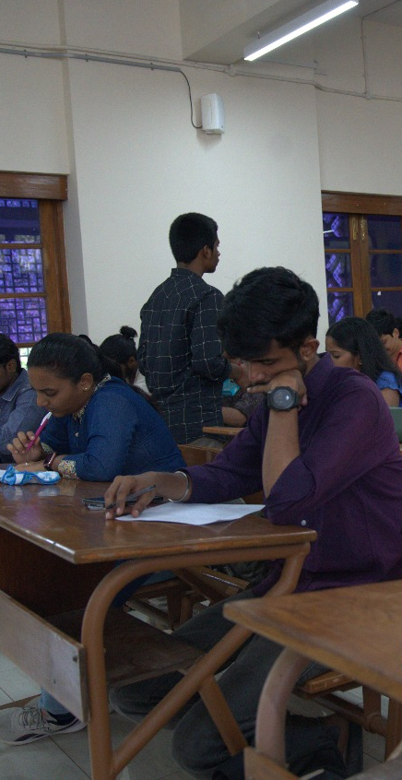
BENEFITS OF ATTENDING FEST
Get certificates
Prize pool worth 1.5lakh
Increase connections and enhance network
Showcase your talent to professors and industrialists
Drop your resumes and get chance of internships
CEA FEST 2025

